Slide 1
Tutorial: An In-Depth Look at
Modern Database Systems
C. Mohan
IBM Fellow and Former IBM India Chief Scientist
IBM Almaden Research Center, San Jose, CA 95120, USA
cmohan@us.ibm.com http://bit.ly/CMohan
Updated Version (15 Oct 2013) of Tutorial Presented First at
39th International Conference on Very Large Data Bases (VLDB)
Riva del Garda, Trento, Italy, 29 August 2013
Link to Slides and Bibliography at http://bit.ly/CMnMDS

Slide 2
Background + Warnings
My personal opinions, NOT necessarily IBM’s positions/opinions
Lots of hype on NoSQL (lesser on NewSQL) in industry, academia & VC world – this Kool-Aid has intoxicated many ☺
Been a details oriented, hard core DB person for > 3 decades –
I go beyond hype, am not easily swayed by the latest fashion!
Not a relational bigot – most of my results on systems topics have applied to all sorts of persistent, distributed information systems
Have dissected many IBM and non-IBM systems’ internals (including pre and post relational ones)
Don’t claim to have all the answers or make definitive assertions
Aim of tutorial: not exhaustive survey of modern systems or details of too many specific systems – broad brush analysis of good (sensible) and bad (nonsenSQL) of NoSQL/NewSQL, warn of pitfalls –
time to pause and introspect. Give a few systems’ interesting details.
NOT against NoSQL but unhappy with choices on internals and justifications (“anything goes” attitude) and not learning from the past

Slide 3
Some Quotes
Jack Clark, The Register, 30 August 2013: “The tech world is turning back toward SQL, bringing to a close a possibly misspent half-decade in which startups courted developers with promises of infinite scalability and the finest imitation-Google tools available, and companies found themselves exposed to unstable data and poor guarantees.”
Spanner paper, October 2012: “We believe it is better to have application programmers deal with performance problems due to overuse of transactions as bottlenecks arise, rather than always coding around the lack of transactions.”

Slide 4
Introduction
Goal: Broad Survey of Modern Database Systems (MDS)
Drivers Behind Emergence of MDS, Benchmarks/Performance Studies
Classes of MDS
  Evolution of Classical DBMSs (DB2, SQL Server, Oracle, Informix)
  Brand New Systems (NewSQL, NoSQL)
  Hybrid Systems (Hadoop + SQL) – to be covered later
Overviews of Specific Systems
  DB2 BLU, IDAA, MS Hekaton, Oracle Exadata, Informix Warehouse Accelerator
  SAP Hana, Google F1, NuoDB, VoltDB, HyPer, Calvin
  Aerospike, MongoDB, Oracle NoSQL, Neo4j, Facebook Tao
Deployments or Use Case Scenarios: Facebook (later LinkedIn, Twitter)
Ack: Figures and tables sourced from documentation/papers/web pages!

Slide 5
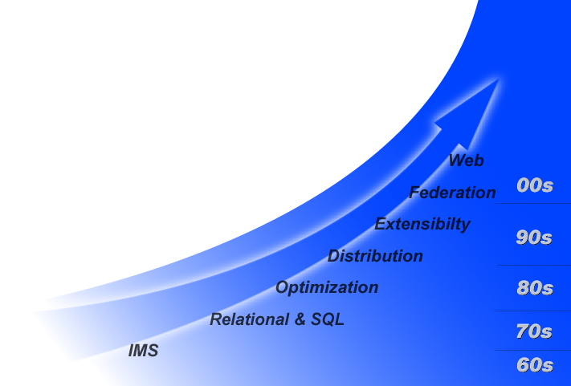
Evolution of Database Systems
MDS
10s
10s
MDS
Notes:
After delivering some of the first databases in the 1960's (e.g. IMS) IBM invented today's relational database model in the late 70's. Since shipping the first relational database for host systems in the early 1980's, IBM has continued our innovation as shown by our current patent portfolio and standards leadership. We still have many active data management projects as part of IBM's $6B research investment, and we have a special team – the Database Technology Institute – that helps bridge that research quickly into production products.
Evolution of relational technology has occurred since those early shipments.
The first focus was providing transaction support for high performance requirements. This work highlighted query optimization inventing cost-based optimization and today gives DB2 the worlds most mature optimizer. DB2’s optimizer is the basis for high performance out of the box. It reduces the skill and time necessary to get fast performance.
In the early 1990’s the focus expanded to managing distributed database objects, recognizing the explosion of information and distributed computing model that was emerging. This built on our core cost-based optimization capabilities and provided transparent access to distributed relational objects. Now a programmer to access and treat distributed tables as if they were local - with no changes to an application or any need to learn an new SQL dialect.
In the mid-90s, DB2 was the first RDB to deliver object extensions to its relational model. This provided an extensible architecture which includes a robust semantic model that is the basis for expressing complex objects and relationships. Including support such as complex data types, user-defined functions, triggers, recursion and stored procedures made it dramatically simpler to develop applications. At the same time, this enabled DB2 to enforce business rules helping ensure consistent use of information and add to the integrity of business processes.
DB2 has built on it’s foundation of cost-based optimization and support for distributed objects along with its ability to express complex objects with a focus on supporting heterogeneous structures. The focus on federation allows DB2 to extend development and management productivity to manage all kinds of objects, relational and otherwise: through a single interface, with high performance out of the box.
DB2’s strategy and evolution has positioned it to support today’s critical solutions beyond it’s core support for optimized transactions and the fundamental rich data management foundation providing high performance, scalability, availability, and security.
The next step in evolution is to support the web and evolving techology models.
For instance, DB2 deeply integrates the self-defining schema’s of XML. XML represents a quantum leap forward in the ability to interchange data and metadata supporting dynamic business processes. DB2 today provides rich support for XML and is expanding this support.
DB2 is the first database to ship industry web services through integration with WebSphere exposing DB2 stored procedures and XML objects via SOAP. This evolution will continue with particular focus on optimizing support for UDDI and further integration with the WebSphere Application Server and WebSphere development tooling.
That evolution has lead to outstanding acceptance in the marketplace with over 400,000 customers trusting DB2 to be the steward of their information. We also have over 16,000 partners who depend on DB2 and deliver the skills and applications that provide a solution to a wide range of business requirements.
IBM continues to be very serious about the data management segment. On top of an already large commitment, IBM invested an incremental $1B in 1997, largely earmarked for increasing our sales team, field support and accelerated development activities. In 2001, yet another $1B investment fueled the acquisition of Informix's database business expanding IBM's DM team with over 2,500 people across development, support and sales, in addition to greatly expanding the customer and partner base.

Slide 6

Evolution of Pre-Modern Database Systems
application
Core Function
  Optimization
  J2EE, XML, SQL
  Web services
  Stored procedures
  Data encryption
  Globalization
Federated Access
  Transparent, optimized access
  Heterogeneous content
    O/R extensions
Embedded Analysis
  OLAP, mining, spatial
  Advanced search
Productivity Tools
  Visual development
  Migration tools
enhanced
relational
database
application
relational
database
application
file system
Notes:
Message:
By delivering more and more application enabling function in DB2, we make it easier and faster to build applications.
Embedded function
J2EE, XML, SQL - the lingua franca of the web today, making it easy to develop portable applications that are easy to integrate
Standards
We don’t do things in a proprietary sense. This makes portability easy. If a standard exists we use it. If one doesn’t exist, we lead an effort.
We have contributed more accepted standards for database than the rest of the industry combined
Web services pave the way for dynamic e-business (SOAP, UDDI)
Stored procedures to provide integrity, reduce maintance and ensure high performance
Expanded security through embedded data encryption to take the burden off the programmer and deliver encryption at db optimized performance levels.
Embedded analysis
A rich set of services available to the programmer...sophisticated analysis in a single line of code
cube & rollup bring dimensional analysis to SQL...
Scoring services bring mining to realtime...
Search - text search, search of XML, in memory searches
Federated
Oracle, SQL Server, Informix, Sybase, flat files, OLE-DB through a single interface
Transparent: takes the burden off the application programmer to understand all the different semantics and syntaxes databases and file systems.
It also insulates the application from changes in the data infrastructure reducing maintenance by orders of magnitude
Optimized: query re-write takes the emphasis off tweeking application level SQL. the application through tuning

Slide 7
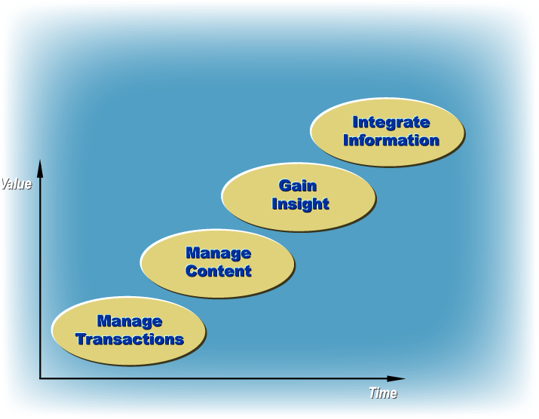
Evolution of Pre-Modern Database Systems
Leveraging information to gain competitive advantage
Notes:
Companies’ information needs are evolving as e-business evolves. e-business transactions require an increasingly heterogeneous base of information to fuel business differentiating applications.
Transactions still need to be fast, secure, and always available. Further, e-business transactions need to be “content complete” - manage forms of information beyond simple rows and columns of alpha-numeric information such as XML formatted information, images, streaming video, and other rich media formats. As well, these new information types and applications drive requirements for new services, such as digital rights management.
However, e-business transactions need to add value to information with embedded analysis to support real-time decision making. By leveraging the entire digitized information asset, companies can improve customer service, operate more efficiently and become more competitive.
Over the years, IBM Data Management has invested in the transaction, business intelligence, and content management markets. e-business is driving the convergence of these markets. This presence and experience base will uniquely position IBM to provide an integrated information infrastructure supporting the needs of the emerging e-business transactions model.
Most of the data management evolution is driven by e-business. Let's see how that is evolving...

Slide 8
Drivers of MDS Features
Hardware Trends: Multicore, InfiniBand, DRAMs, SSDs, FPGAs, GPUs, SCMs
Big Data (esp. Semi-Structured): Compression, Column Handling, Scalability (Sharding), Avoiding Data Loading, Linkage to Analytics Tools, …
Wider Adoption of Database Technology: Ease of Use, Appliances
Monetary Constraints: Open Source, Commodity Processors/Disks, Local Disks, Economic Factors in General
Skills Shortage: DBAs, Admins in General, SQL Knowledge, …
Social Media: Relationship Graphs, Ultra Low Response Times, Data Heterogeneity/Volume, Mobile Users
Internet of Things (IOT): Smarter Planet, Sensors, Low Power, …
Cloud Platforms: Elasticity, Multi-tenancy, Security, Transborder Data Flows

Slide 9
Hardware Trends
DRAM costs 17X SSD! Dell $20/GB DRAM (16 GB DIMM $315)
SSD 10X HDD cost ($0.10/GB, 200 IOPS)
SSD: Samsung 840, 250 GB, $180
4 drives/chassis: 1 TB, 384K read IOPS, 248K random write IOPS, $720, 0.3 Watts
DBs under 100 GB: DRAM
100 GB – 2 TB: SSD
>1 PB: HDD
Open source Aerospike Certification Tool for SSDs for real-time use cases

Slide 10
Benchmarking Conclusions
OLTP workloads in traditional DSs don’t leverage aggressive micro-architectural features, wasting time in memory stalls, resulting in low instructions per cycle (IPC)
EPFL study: L1 instruction misses cause significant stall times with index probes dominating instruction & data stalls
H-Store work: significant time spent in lock/latch code, buffer pool fixes/unfixes
Sort Vs Hash join revisited in multicore systems

Slide 11
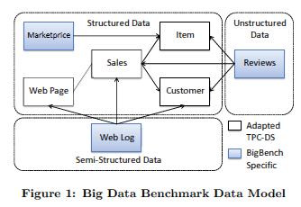
Benchmarks
LinkBench: Benchmark Based on Facebook Social Graph
BigBench: Benchmark for Big Data Analytics
  Product Retailer Scenario
  Addresses Variety, Velocity & Volume of Big Data
  Structured (TPC-DS), Semistructured (user clicks), Unstructured (product reviews)
  Queries Cover Analytics Proposed by McKinsey: Marketing (Cross Selling, Customer Micro-Segementation, Sentiment Analysis, Enhancing Multichannel Consumer Experience), Merchandising (Assortment Optimization, Pricing Optimization), Operations (Performance Transparency, Return Analysis), Supply Chain (Inventory Management), New Business Models (Price Comparison)
  Feasibility Illustrated via Teradata Aster Database’s SQL-MR

Slide 12
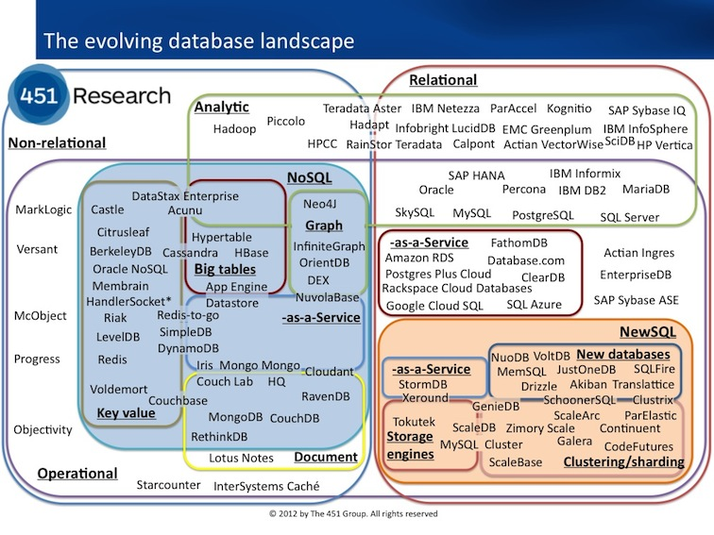
Database Product Landscape – Matthew Aslett 11-2012
http://blogs.the451group.com/information_management/files/2012/11/DBlandscape.jpg

Slide 13
Unable to Cover in Detail
Facebook:
  Scuba (Real-time analysis: In memory, SQL-, SN)
  Unicorn (Social graph search: In memory)
LinkedIn: Espresso (Document data platform: hierarchical data model, cluster management, change capture, inverted indexing, MySQL replication+)
Streaming Systems: Scribe (Facebook), Flume (Apache), Kafka (LinkedIn), MillWheel (Google)

Slide 14
Unable to Cover in Detail
CWI/Actian: MonetDB/Vectorwise (Column store, micro adaptivity)
UC Berkeley: Shark (SQL & rich analytics at Scale)
ETH Zurich: SharedDB (Batching queries, shared computations, OLTP also)
Stanford: RAMCloud (Aggregating DRAM across cluster with InfiniBand, key value store, log structured, novel backup/recovery)
EPFL: NoDB (Raw data, data-to-query time, PostgresRaw)

Slide 15
Evolution of Classic Database Systems

Slide 16
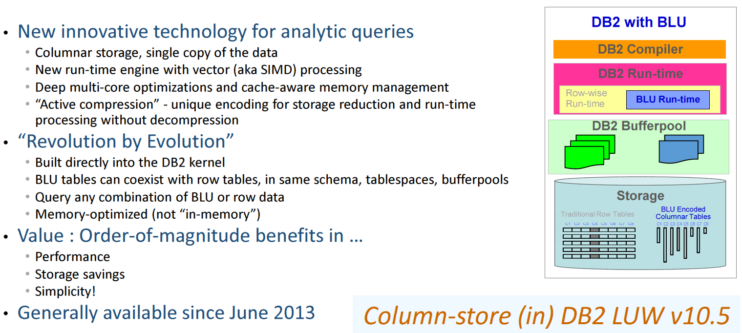
DB2 with BLU Acceleration

Slide 17
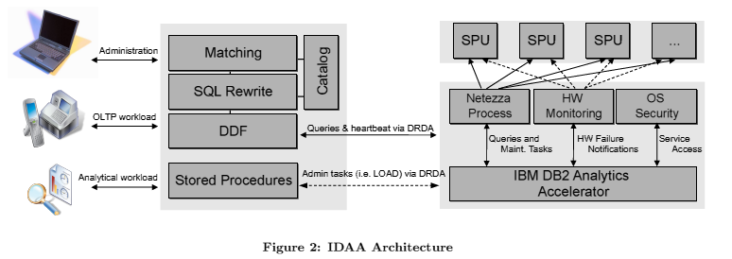
IBM DB2 Analytics Accelerator (IDAA)
Data from DB2 z replicated continuously to Netezza
Offload complex queries from DB2 z to Netezza for more efficient/cheaper execution
Queries execute with snapshot semantics since Netezza supports MVCC
Replaced IBM Smart Analytics Optimizer (ISAO) where Blink technology was used
Evolution of Blink is what is now in DB2 BLU

Slide 18
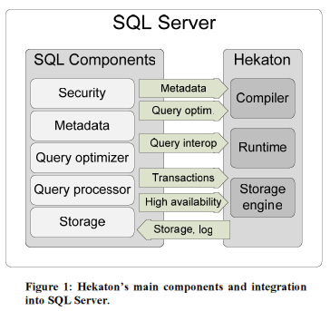
Hekaton: SQL Server’s In-Memory OLTP Engine
Alternate data manager integrated with SQL Server
All Hekaton data in memory with lock/latch-free optimistic, multiversion concurrency control
Declare table to be memory optimized
T-SQL stored procs accessing only Hekaton tables compiled into machine code
Hash and range indexes
Optionally non-durable tables
Index updates not logged; rebuilt during recovery from checkpoint and logs.

Slide 19
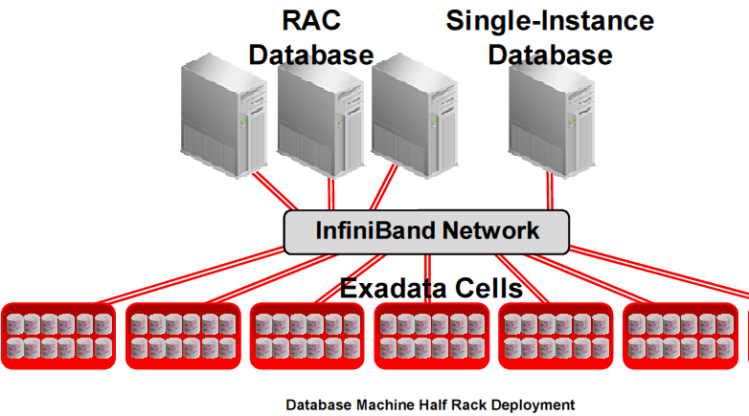
Oracle Exadata

Slide 20
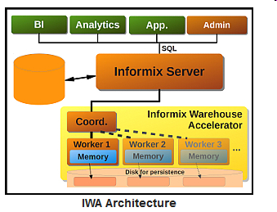
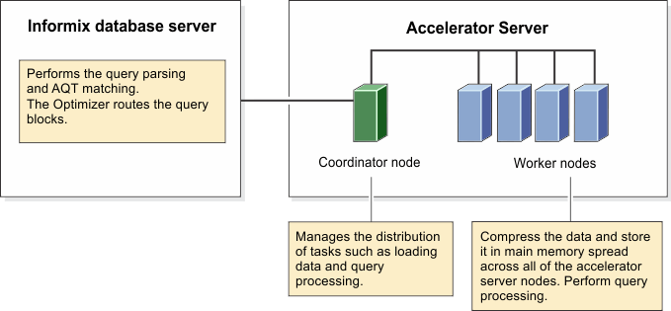
Informix Warehouse Accelerator
Informix Warehouse Accelerator: Based on IBM Almaden’s Blink technology which was originally released as part of IBM Smart Analytics Optimizer (ISAO) for offloading mainframe DB2 queries

Slide 21
NewSQL Systems

Slide 22
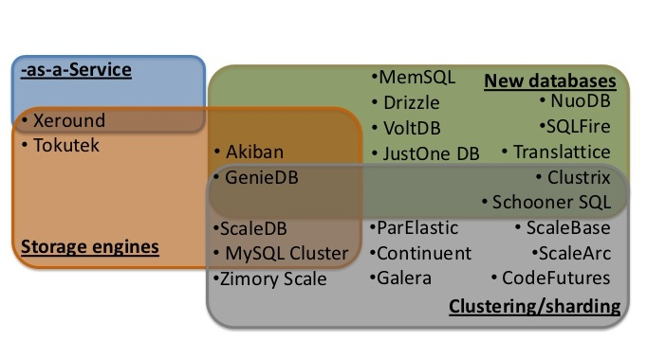
NewSQL Ecosystem - Matthew Aslett 2012

Slide 23
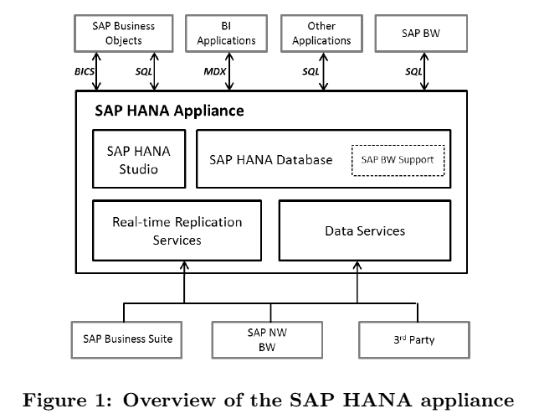
SAP Hana
Extensible platform for many query languages (incl SQL)

Slide 24
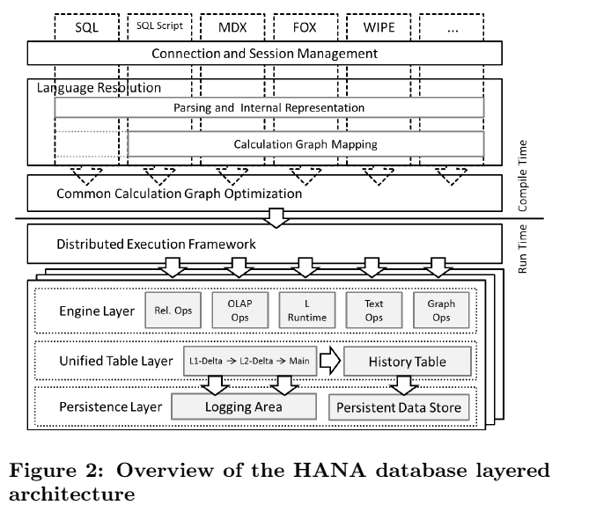
SAP Hana

Slide 25
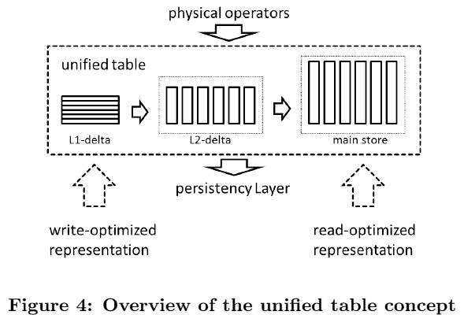
SAP Hana
L2 delta dictionary encoded, no compression for L1
Main store maximally compressed with many schemes

Slide 26
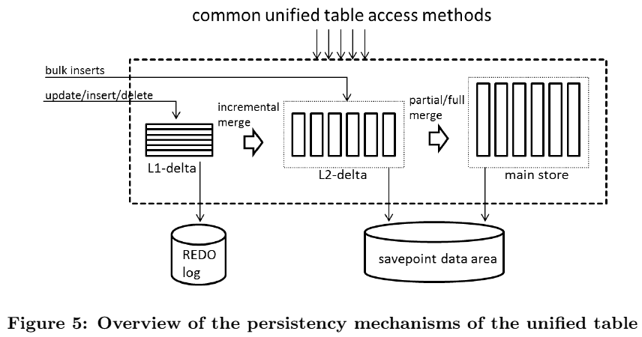
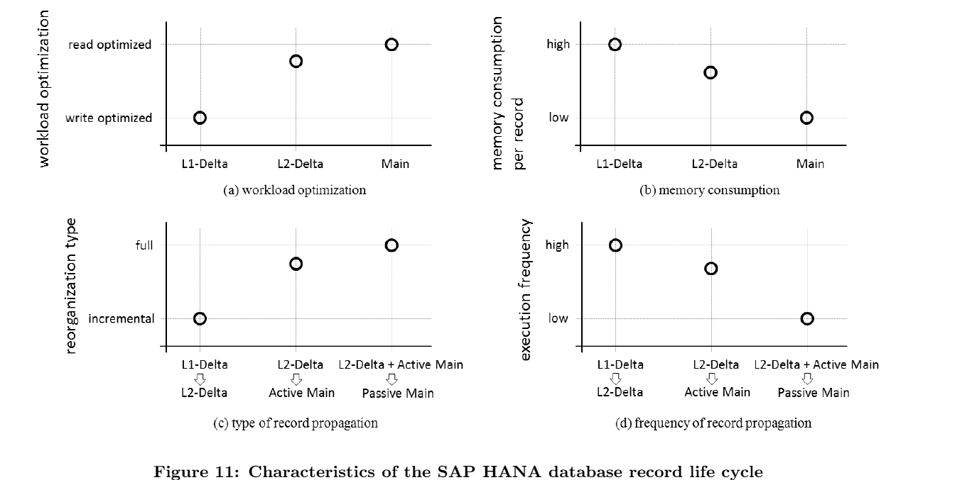
SAP Hana

Slide 27
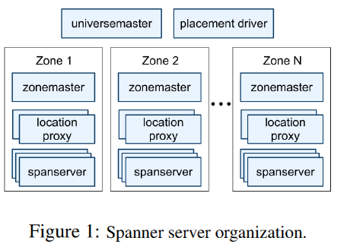
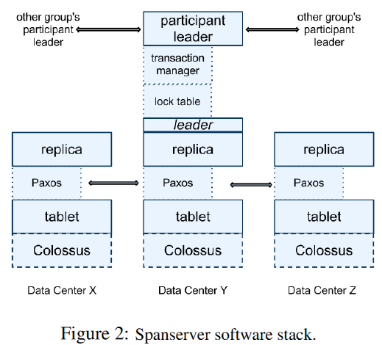
Google Spanner
Globally distributed semi-relational system, SQL-based query lang
Transactional, relies on TrueTime and Paxos

Slide 28
Google F1
Developed for use with AdWords platform replacing MySQL
Relies on Google Spanner
Distributed SQL queries for OLAP-style queries, using snapshot transactions
and two phase commit
Optimistic concurreny control
Transaction consistent secondary indexes
Protocol Buffer as column data type
Clustered hierarchical tables
Increased read, write and commit latencies
5 copy replication
Row or sub-row level locking
Many issues found with inefficiencies of MySQL ORM layer – replaced with F1 ORM
Multiple client consumers of a single query’s results

Slide 29
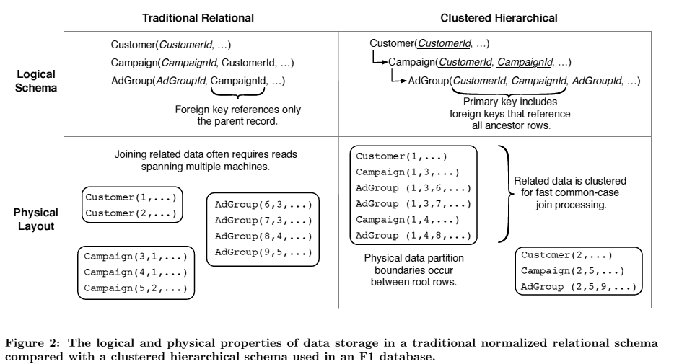
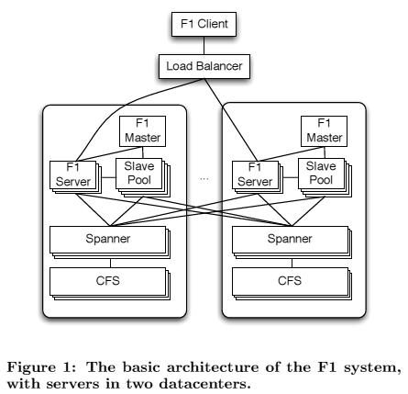
Google F1
F1: A Distributed SQL Database That Scales

Slide 30
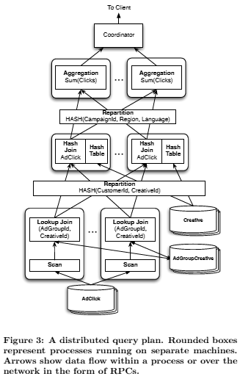
Google F1

Slide 31
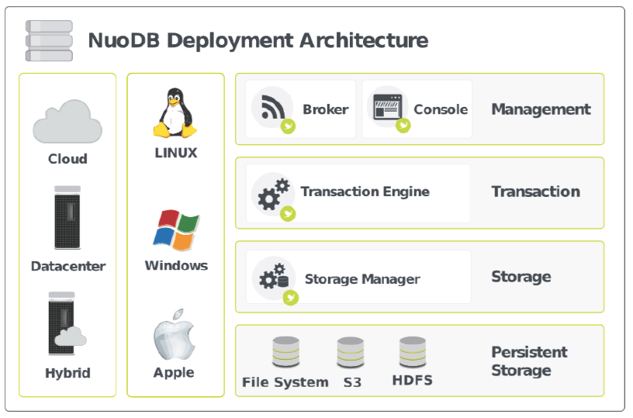
NuoDB
Separates transaction management from storage management – Transaction Engines and Storage Managers
TEs manage data via partial, on-demand replication
Data resides where it is needed and used
NuoDB Cloud on Amazon AWS
Uses multi-version concurrency control (MVCC)

Slide 32
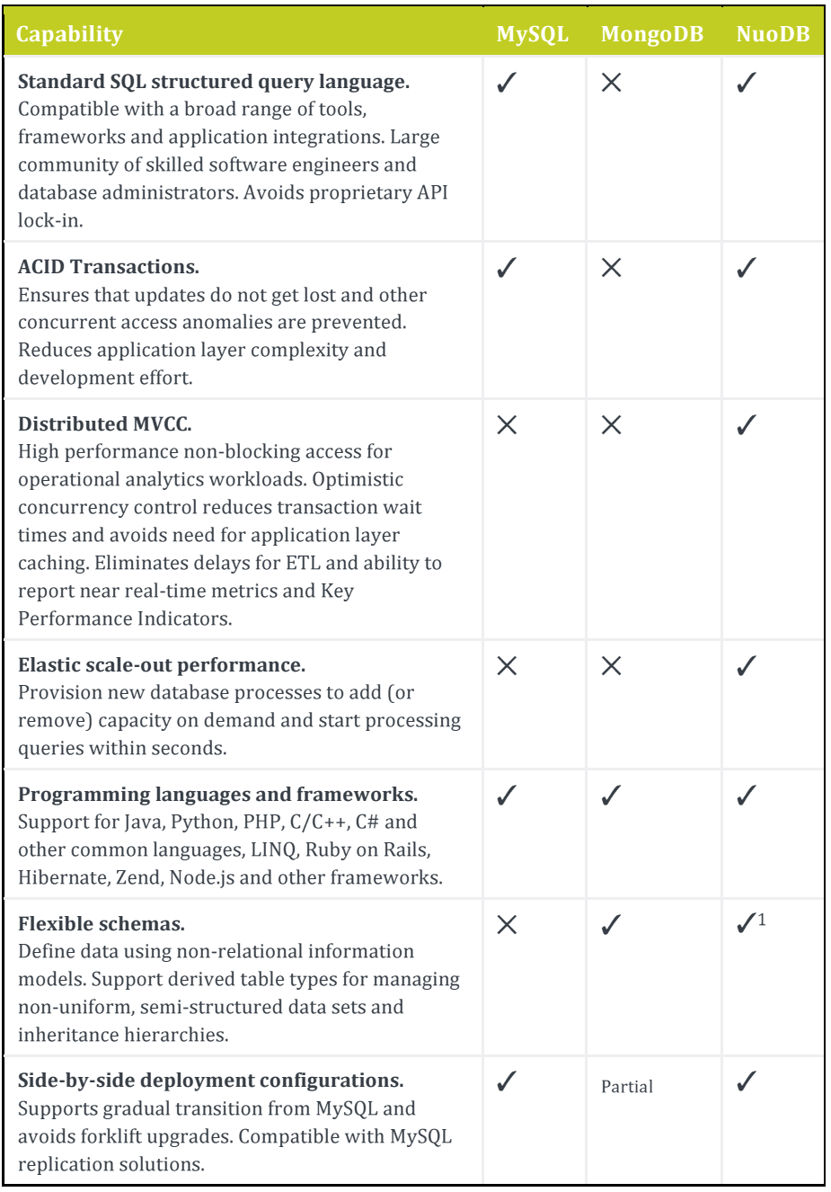
NuoDB

Slide 33
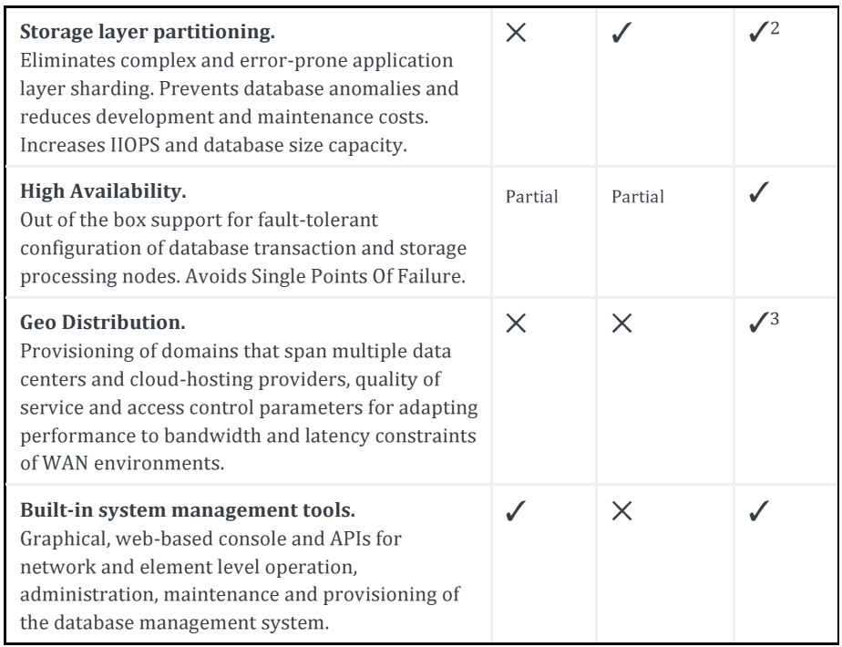
NuoDB

Slide 34
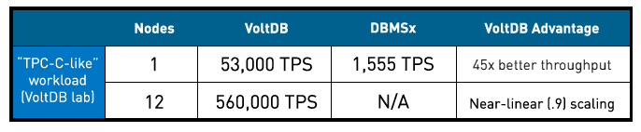
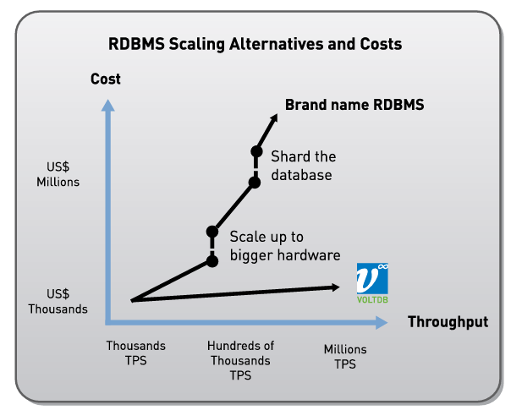
VoltDB (H-Store product)
The Hype on it!

Slide 35
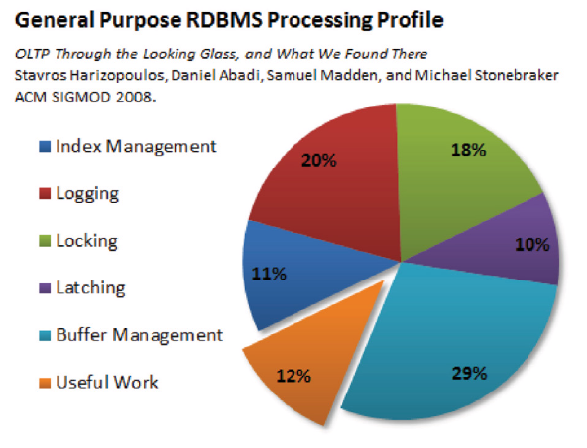
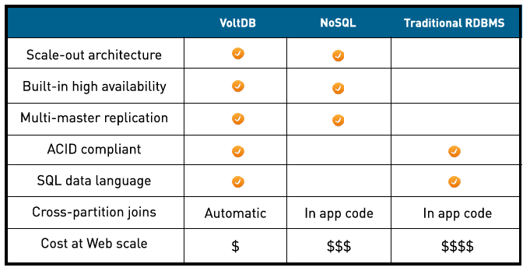
VoltDB

Slide 36
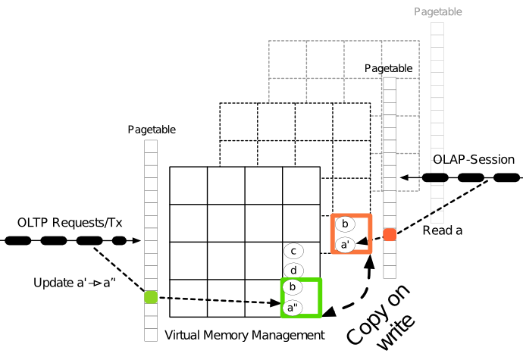
HyPer (Tech Univ Munich)
Hybrid OLTP-OLAP system
In memory
HW assisted replication via VM features

Slide 37
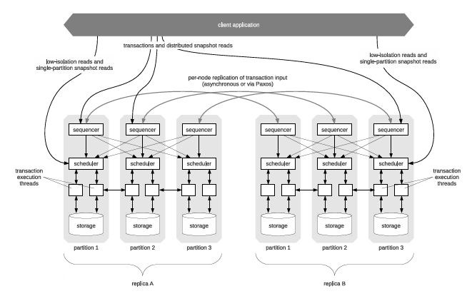
Yale’s Calvin
Scalable transaction layer over shared nothing storage system
Sequencing, scheduling and storage layers
Deterministic locking, Logging transaction inputs, …

Slide 38
Facebook Scuba
In-memory data store
Real time focus, analysis of infrastructure events (servers, network, software)

Slide 39
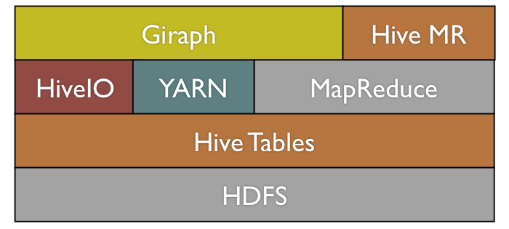
Apache Giraph
Giraph adds several features beyond the basic Pregel model, including master computation, sharded aggregators, edge-oriented input, out-of-core computation, and more
Facebook scaled it work on a trillion edges graph

Slide 40
NoSQL Systems

Slide 41
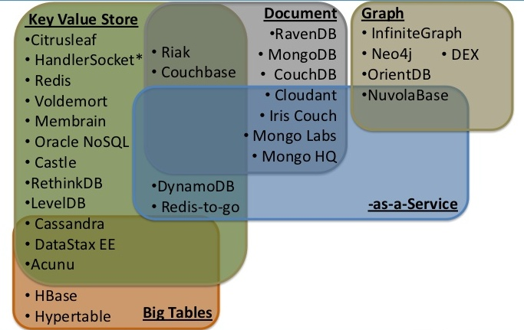
NoSQL Ecosystem - Matthew Aslett 2012

Slide 42
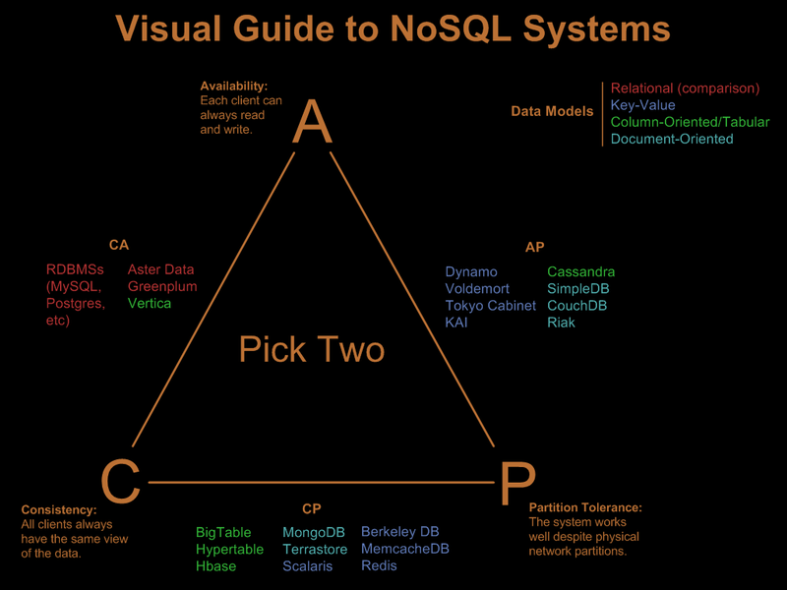
One View of NoSQL Systems – Nathan Hurst, 3/2010?
http://blog.nahurst.com/visual-guide-to-nosql-systems

Slide 43
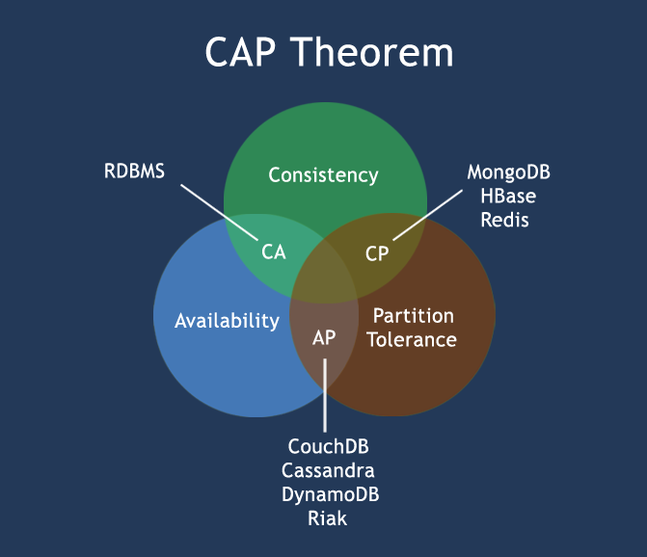
Another Classification – w3resource
http://www.w3resource.com/mongodb/nosql.php

Slide 44
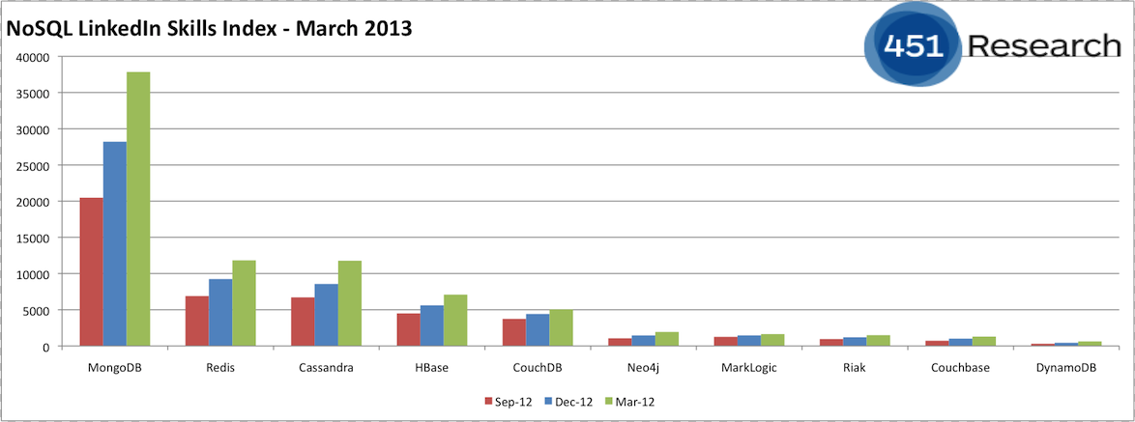
NoSQL LinkedIn Skills Index – 3/2013, Matt Aslett

Slide 45
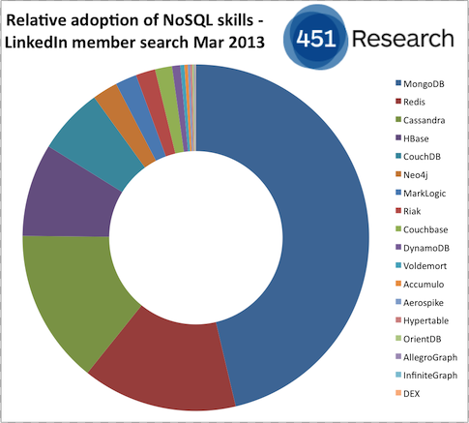
NoSQL LinkedIn Skills Index – 3/2013, Matt Aslett

Slide 46
Motivations for NoSQL Systems
Need for flexible data model, schema evolution, …
Many apps (e.g., Web2.0) need fewer features, high scale (data sizes, # of servers), very low response times
Native support for interchange/storage formats like JSON
Sharding RDBMS DBs rigid or unfriendly
High-scale RDBMS too expensive for simple apps
Need for low-latency, low-overhead API to access data
Need to scale-out on cheap commodity nodes with locally-attached SATA disks, especially in cloud context
Increasing use of distributed analytics
Desire for one programming language for imperative programming and persistent data accesses (ref: POS)
For some, access to source code for tailoring for their needs
Flexibility with respect to data consistency

Slide 47
Concerns/Misgivings (NonsenSQL …)
Throwing baby with bath water analogy comes to mind … many very good developments of last 3 decades discarded … but lot of them coming back … albeit in ad hoc ways on a flaky base
Many past systems that started simple ran into many scalability and other issues – S/38, AS/400, Lotus Notes/Domino, OODBMSs and RDBMSs with page as smallest unit of locking (e.g., mainframe DB2, Sybase/SQLServer, ObjectStore), Single level stores, …
Seat of the pant design in newer systems by highly inexperienced people who haven’t done their homework AND who aren’t documenting enough their designs for others to recognize their deficiencies
Too many misleading claims on novelty of some design features
Ridiculous choices like database level lock in MongoDB
Object granularity as unit of replication locally and for disaster recovery remotely
Myths about ACID transactions and relaxed notions of consistency

Slide 48

Web 2.0 Companies
RDBMS and SQL embedded in a general programming language and memcached: Used by Facebook, Twitter, …
memcached
memcached
PHP, Python,
Ruby, Perl,
Java, C, C++, C#
memcached
memcached
RDBMS
SQL

Slide 49
Web 2.0 Companies
Some people abandoned RDBMS for non-relational stores
PHP, Python,
Ruby, Perl,
Java, C#
Dynamo, Cassandra,
BigTable, CouchDB, …

Slide 50
Indexing
Most stores rely on hash-based storage method
  Typically one object, one node, one key API calls
  Fast but quite inflexible
  Sharding knowledge possibly on client side
Naïve attempts to provide alternate key support
  Reinventing notions of primary & secondary indexes (not just in NonStop SQL but even in IMS and VSAM)
  Systems like DB2 implemented for partitioned tables, local & global indexes with eye towards partition independence
Delayed/bulk updating of indexes nothing new (e.g., Notes)
If high concurrency not a goal, index locking/recovery simple – scaling will be a nightmare when simple doesn’t work anymore

Slide 51
Data Models
While some cited simplicity as reason for NoSQL, some NoSQL systems have very complex data models
No design tools for such complex models, unlike for RDBMSs
  Would be good to develop them
  Perhaps research community could focus there
With very different APIs across systems, system migrations would be a nightmare
People have forgotten benefits of standardization
What works for big Web 2.0 companies, won’t necessarily work for regular user organizations
Netflix could do major migration which involved app changes (Oracle to AWS) but not a simple story at all

Slide 52
Document Stores
Not at all new contrary to popular belief in NoSQL world!
Lotus Notes released in 1989 with sophisticated features
  Flexible schemas (self describing)
  Field level encryption, authorization
  Sophisticated multilevel indexes with asynch support
  Replication and disconnected operation
  Versioning
But many simple minded features
  No buffer manager – reliance on file system caching
  Mish mash of data structures in a single file
  Vague failure guarantees
  No log
Nightmare to add scalability, log-based recovery in R5
MongoDB and Couchbase designers need to learn a lot from Notes!

Slide 53
Myths About Transactions
False claim that NoSQL systems introduced relaxed transaction semantics!
From System R, degrees of isolation supported; soft commits in in-memory DBMSs and recovery compromises in TPF
Single API weak transaction notion was in Notes
Even if users don’t see transaction notion, system internals need something stronger to keep internals sane, especially with incremental update support!
Assertions on scalability can’t be selectively invoked! Even if users don’t need high concurrency, system internals will need it (storage management, etc.)
Even FB developers felt eventual consistency was too much to deal with by them and so chose Hbase for FB messaging!

Slide 54
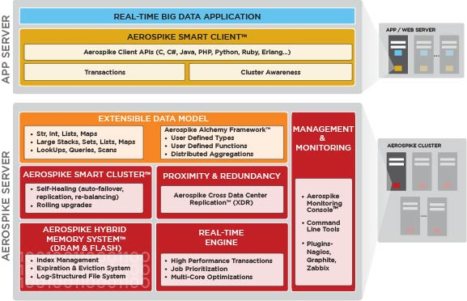
Aerospike
Advocates a hybrid DRAM & Flash system with indexes stored in DRAM & data in flash, disks for persistence
Direct access to flash with own LFS, optimized via small block reads and large block writes
Shared nothing with data distribution using randomized hashing and identical nodes
Uses Paxos for cluster configuration, not for commit logic: all nodes have to agree, not just a majority
Implemented in C for speed with an extensible data model
Master/Slave and Master/Master replication supported
Acquired alchemyDB (used Redis before) being ported onto Aerospike

Slide 55
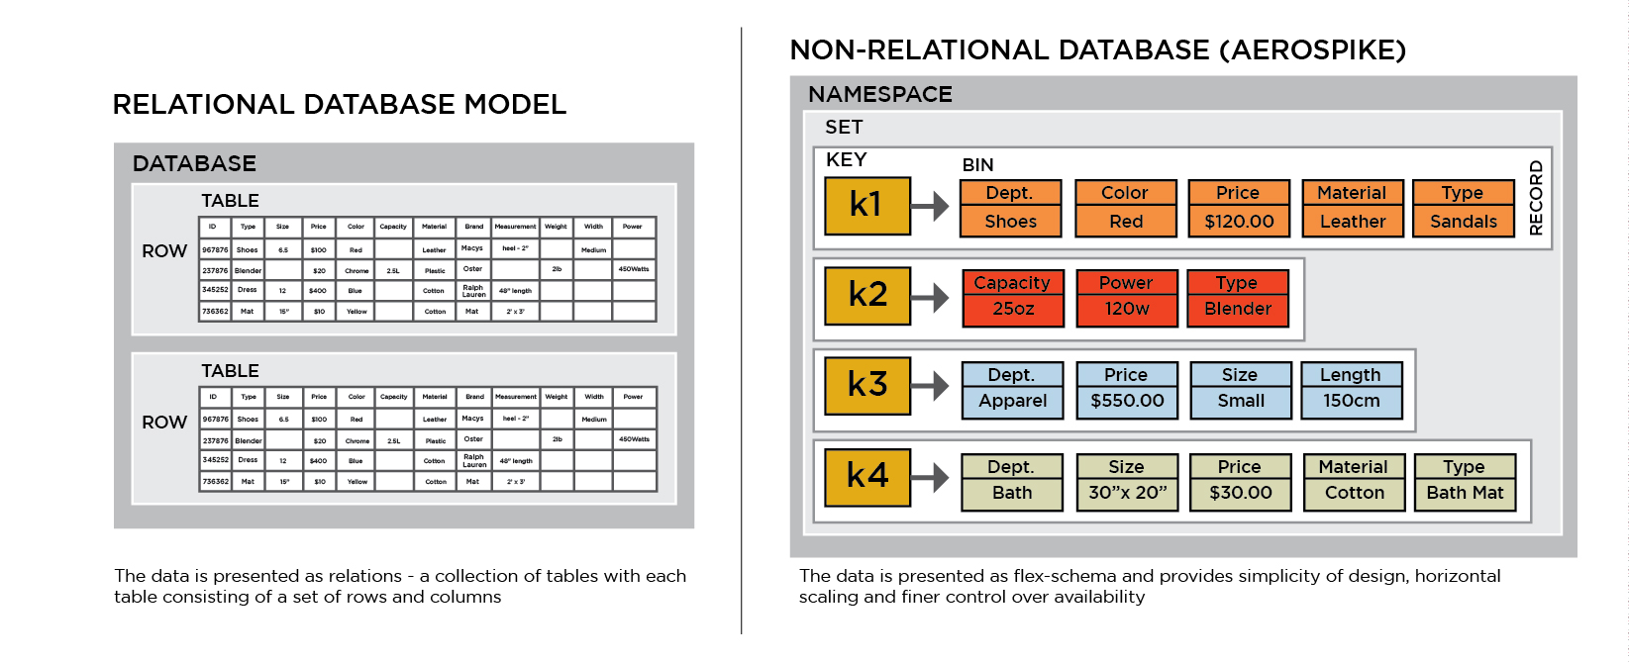
Aerospike
500K TPS on $2K server
1M TPS on $5K server
$1 for 250 TPS
Scaling by mitigating network-I/O-soft-interrupt overhead & avoiding unnecessary context switches – isolate NIC-Physical CPU, NUMA sensitive memory allocation, dedicated core for NIC hardware interrupt handling on > 4 core CPUs

Slide 56

MongoDB
Open source document database system (similar to Lotus Notes)
1st release in 2009, Company behind it: MongoDB, Inc
Native support for JSON-like docs with dynamic schemas (BSON)
Indexing, including secondaries
Master slave replication and high availability
Auto sharding
Simple query support
MapReduce functionality could be invoked for complex aggregation
Relies on file system for buffering
GridFS for very large files storage
Common use cases: operational and analytical big data, content management/delivery, mobile/social infrastructure, user data management and data hub.

Slide 57
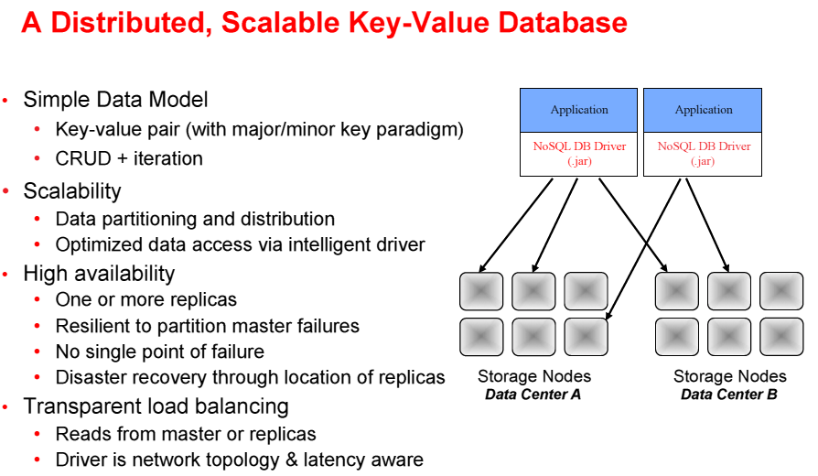
Oracle NoSQL

Slide 58
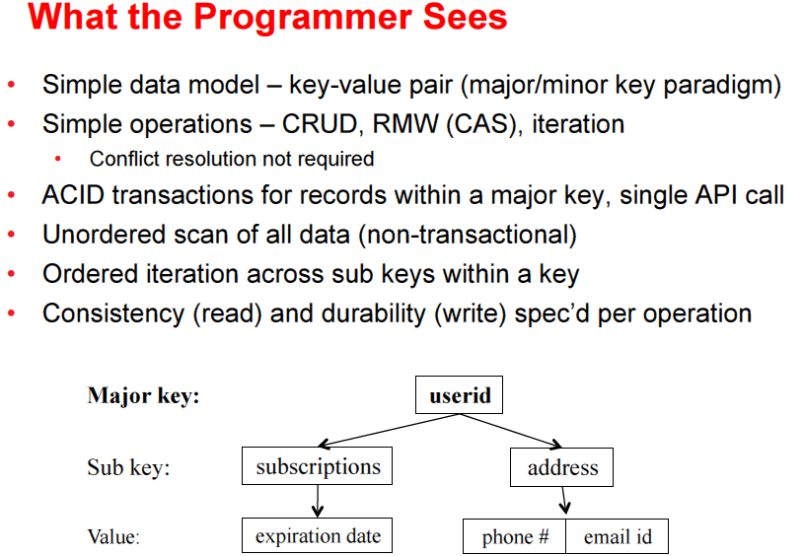
Oracle NoSQL

Slide 59
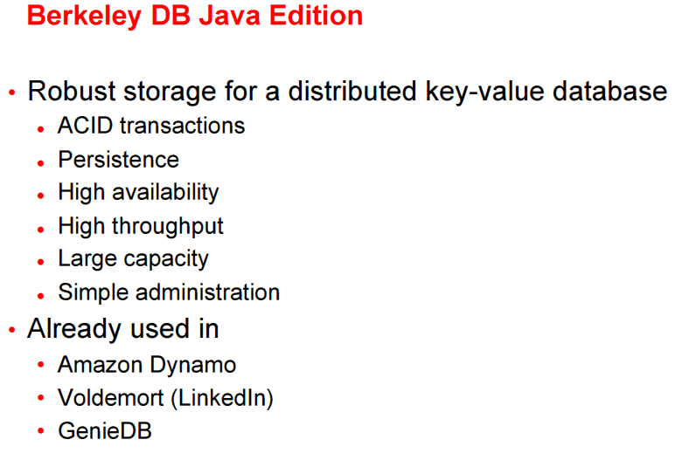

Oracle NoSQL Building Block

Slide 60
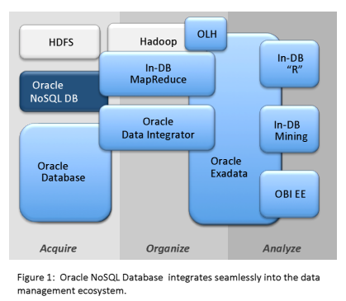
Oracle NoSQL

Slide 61
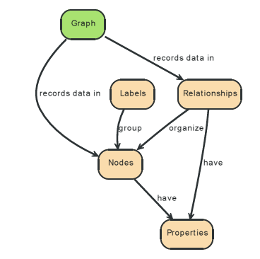
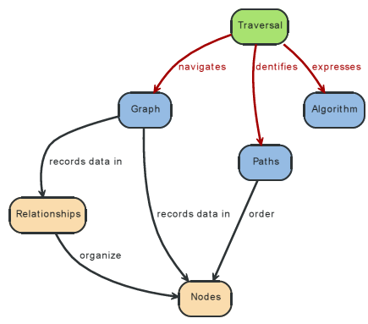
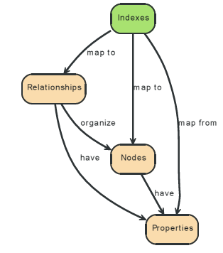
Neo4j
Graph DBMS with Cypher declarative query language + optional schema
ACID transactions

Slide 62
Neo4j
The query language is comprised of several distinct clauses.
• START: Starting points in the graph, obtained via index lookups or by element IDs.
• MATCH: The graph pattern to match, bound to the starting points in START.
• WHERE: Filtering criteria.
• RETURN: What to return.
• CREATE: Creates nodes and relationships.
• DELETE: Removes nodes, relationships and properties.
• SET: Set values to properties.
• FOREACH: Performs updating actions once per element in a list.
• WITH: Divides a query into multiple, distinct parts.

Slide 63
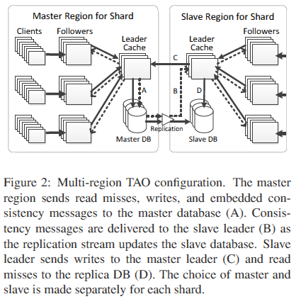
Facebook Tao
Distributed data store for the social graph
Eventual consistency
Replaces Memcache as cache manager on top of MySQL
FB data not easily partitionable
Impossible to generate views presented to users ahead of time
Request rates on some items could spike significantly

Slide 64
Other In-memory NoSQL stores with persistence
Richer data model plus adding (some) durability
Redis (open source http://code.google.com/p/redis/ )
  Values are not limited to strings: lists, sets, ordered sets, hashes
  Persistence: Async. snapshots or append-only log
  Master-slave replication
  Reliable only if fsync every append to journal – very slow; otherwise agree to lose X sec of data; or use expensive memory replication to reduce the risk of data loss
Riak Basho (open-source http://www.basho.com/)
  A Dynamo-inspired document-oriented database
  Eventual consistency, multi-version concurrency, replication
  Reliable with Bitcask as a backend store: A hash map of file pointers to values in memory and an on-disk log → all keys in memory but the data is on disk

Slide 65
Facebook Case Study
mySQL + memcache for real time access to PBs of data
TAO for consistency across big geographies
Haystack for managing photos (3B new ones per week)
Apache Hadoop for mining intelligence from 100PBs of click logs
Apache HBase for FB messages
Data warehouse in Hive
Scuba for real time event data handling – in-memory

Slide 66
Summary
Good that many shortcomings of RDBMSs began to be addressed by user community (Web 2.0 companies)
More rigor needed in rationalizing design choices
Just because data model isn’t relational doesn’t mean internals have to be different or lessons from the past don’t apply
Let us not rediscover problems and adopt solutions with significant shortcomings
Longer time issues not considered in addressing more immediate needs (migration, skills, tools, optimization, …)
Let us not allow history to repeat itself

